Slide 1

Design of pattern recognition system
Dr. Umarani Jayaraman
Assistant Professor

Slide 2
Design of pattern recognition system
Pattern is represented with set of values known as features
Features depend on the problem. Measure ‘relevant’ quantities.
After feature extraction, each pattern is a vector
Classifier is a function to map such vector into one of its class labels
Many general techniques are available to design a classifier
Need to test and validate the final system

Slide 3
Machine recognition of patterns (recap)
Feature extractor makes some measurements on the input pattern
X is called feature vector, often X ϵ R^{d}
Classifier maps each feature vector to a class label
Features to be used are problem specific
Feature Extractor
X
Classifier
Pattern
Class Label

Slide 4
Some Notation
Feature space, X- set of all possible feature vector
It is represented as X={x₁,x₂,..,x_{d}}- d-dimentional feature vector
Classifier: a decision rule or a function h: X {1,2,…C}, C total number of classes
Often X= R^{d}, convenient to take C=2, then we take the labels as {0,1} or {-1,1}
Then, any binary valued function {0,1} on X is a classifier
What h to choose? We want correct or optimal classifier
How to design classifier?
How to judge performance?
How to provide performance guarantees?

Slide 5
Some Notation- contd.
We first consider two-class problem
Can handle the C > 2, if we know how to handle two-class problem
Simple alternative: design C-2 class classifiers ‘One vs Rest’
There are other possibilities such as tree structured classifiers (eg: decision tree)
The two-class problem is the basic problem
We will also look at C-class classifiers

Slide 6
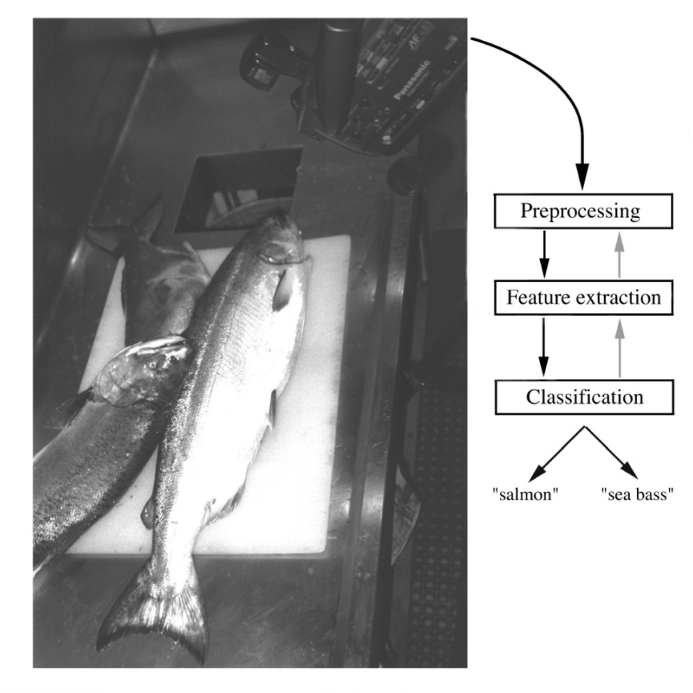
A simple PR problem
Problem: Sorting incoming fish on a conveyor belt.
Assumption: Two kind of fish:
(1) sea bass
(2) salmon

Slide 7

Pre-processing Step
Example
(1) Image enhancement
(2) Separate touching
or occluding fish
(3) Find the boundary of each fish

Slide 8
Feature Extraction
Assume a fisherman told us that a sea bass is generally longer than a salmon.
We can use length as a feature and decide between sea bass and salmon according to a threshold on length.
How should we choose the threshold?

Slide 9
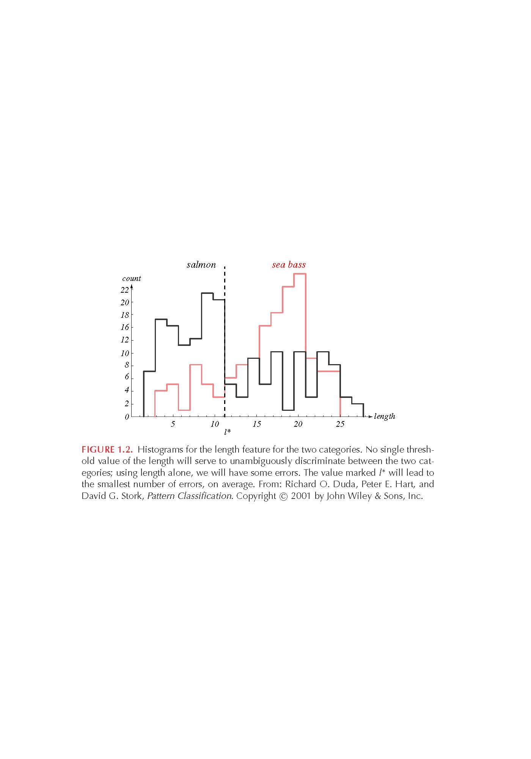
“Length” Histograms
Even though sea bass is longer than salmon on the average, there are many examples of fish where this observation does not hold/failed.
threshold l*

Slide 10
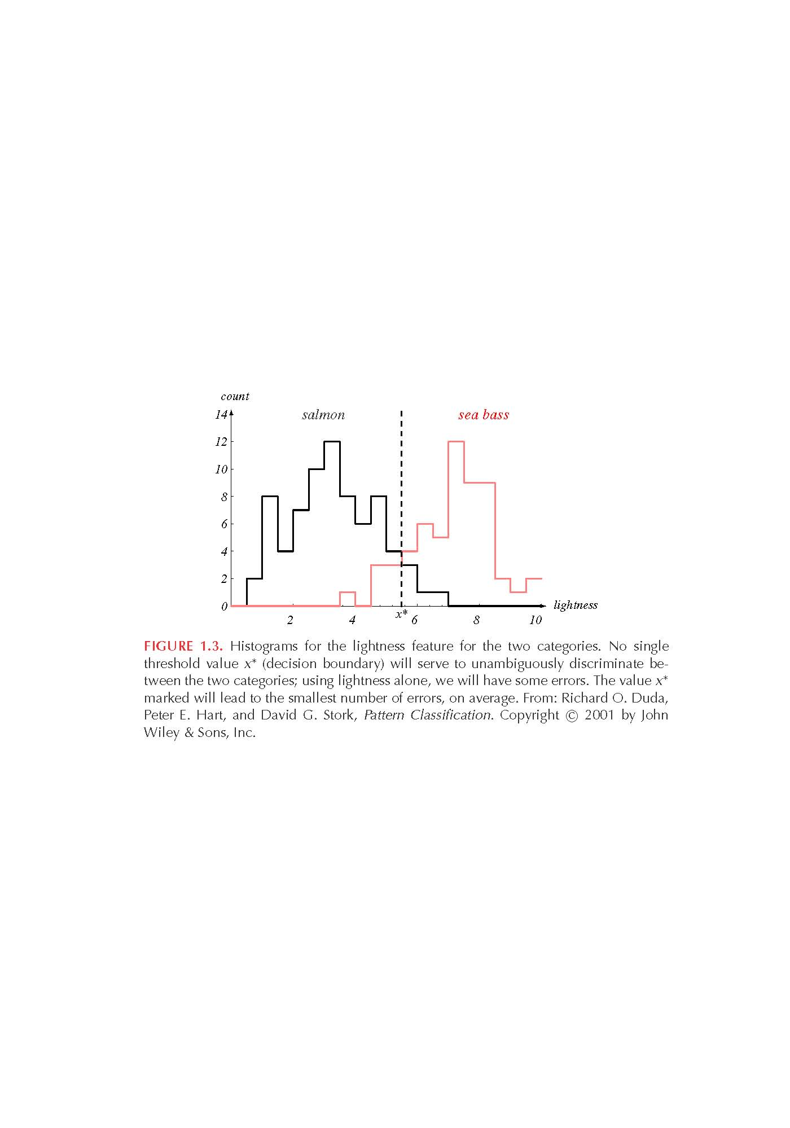
“Average Lightness” Histograms
Consider a different feature such as “average lightness”
It seems easier to choose the threshold x* but we still cannot make a perfect decision.
threshold x*

Slide 11
Multiple Features
To improve recognition accuracy, we might have to use more than one features at a time.
Single features might not yield the best performance.
Using combinations of features might yield better performance.
How many features should we choose?
x₁: length
x₂: lightness

Slide 12
How Many Features?
Does adding more features always improve performance?
It might be difficult and computationally expensive to extract certain features.
Correlated features might not improve performance.
“Curse” of dimensionality.

Slide 13

Feature Extraction
How to choose a good set of features?
Discriminative features
Invariant features (e.g., translation, rotation and scale)
Are there ways to automatically learn which features are best ?

Slide 14
Curse of Dimensionality
The Curse of Dimensionality is termed by mathematician R. Bellman in his book “Dynamic Programming” in 1957.
According to him, the curse of dimensionality is the problem caused by the exponential increase in volume associated with adding extra dimensions to Euclidean space.
The curse of dimensionality basically means that the error increases with the increase in the number of features.
A higher number of dimensions theoretically allow more information to be stored,
But practically it rarely helps due to the higher possibility of noise and redundancy in the real-world data.

Slide 15
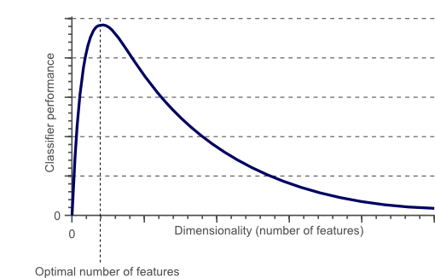
Curse of Dimensionality- definition
As the number of features or dimensions grows, the amount of time/data we need to generalize accurately grows exponentially.“
In applied maths, COD refers to the problem caused by the exponential increase in volume associated with adding extra dimensions to a mathematical space.

Slide 16
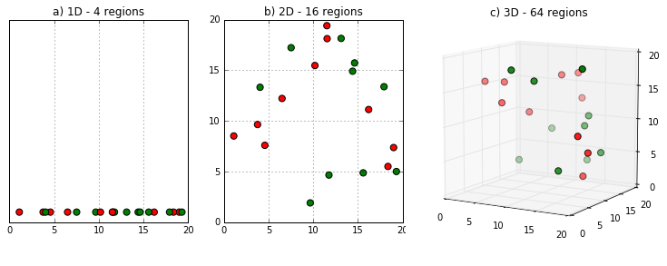
Curse of Dimensionality-(contd)
Fig. 1 (a) shows 20 data points in one dimension i.e. there is only one feature in the data set. It can be easily represented on a line whose range is 20 and divided into 4 regions.

Slide 17
Curse of Dimensionality-(contd)
But if we add one more feature, same data will be represented in 2 dimensions (Fig.1 (b)) causing increase in dimension space to 4*4 =16.
And again if we add 3rd feature, dimension space will increase to 4*4*4 = 64. As dimensions grows, dimensions space increases exponentially.
4^1 = 4
4^2 = 16
4^3 = 64 and so on...

Slide 18
Handling Missing Features
Certain features might be missing (e.g., due to occlusion).
How should we train the classifier with missing features ?
How should the classifier make the best decision with missing features ?

Slide 19
The challenges of features are
Large variation within class: lot of variability in patterns (feature vector) of a single class, intra class similarity is low
Feature vectors of patterns from different classes can be arbitrarily close, inter class similarity is high
Noise in measurements
Given this much variability, it is not so easy to design the classifier
Then how to design a good classifier?

Slide 20
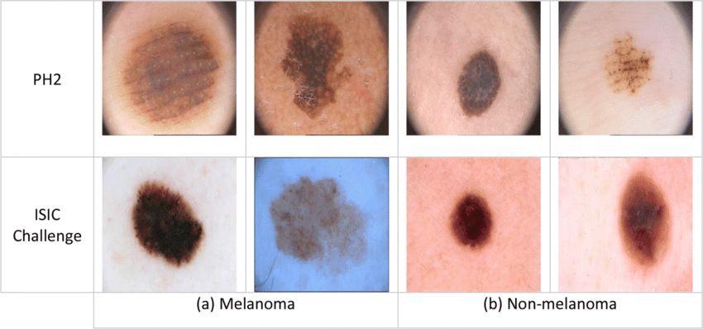
Example for Intra class similarity is low Inter class similarity is high

Slide 21
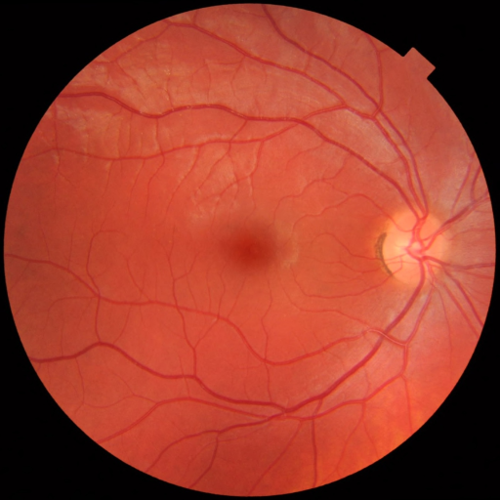
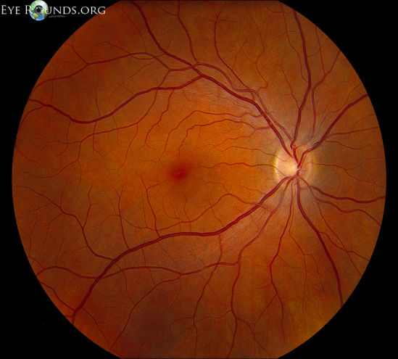
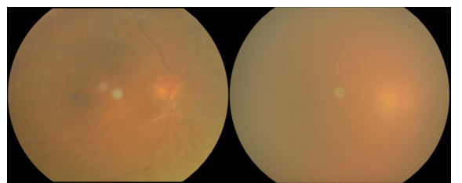
Ideally we need this Example for Intra class similarity is high Inter class similarity is low
Normal
Cataract

Slide 22
Summary
Example PR problem
Feature Vectors
Handling Features
Curse of Dimensionality
Feature Vector and Its Challenges

Slide 23
Thank you

